Slide 1


How to use Open Science to become more visible and amplify your work
www.opensciencemooc.eu
www.eliademy.com/opensciencemooc
@OpenScienceMOOC

Slide 2
This is all online!
Navigate to
https://github.com/OpenScienceMOOC
Go to Module 1, Open Principles
Find the content development folder
Locate Task 2 – available in markdown, as a PDF, or in iPython notebook format
https://github.com/OpenScienceMOOC/Module-1-Open-Principles/tree/master/content_development
@OpenScienceMOOC
www.opensciencemooc.eu

Slide 3
Developing your digital researcher profile
This task is designed for researchers who want to help to build their online profile while helping to amplify their work.
Think of this task like a way of creating an online CV for showcasing your research.
@OpenScienceMOOC
www.opensciencemooc.eu

Slide 4
The four platforms of the open apocalypse
ORCID
A persistent identifier for you and your research.
ImpactStory
A place to document how your research has been shared and re-used online.
Publons
A place to document your peer review activities.
Open Science Framework
A place to openly collaborate on your research.
@OpenScienceMOOC
www.opensciencemooc.eu

Slide 5


Slide 6
Getting your ORCID account
ORCID stands for 'Open Researcher and Contributor ID’.
It provides you with a persistent digital identifier that distinguishes you from every other researcher.
It also neatly integrates with key research workflows such as manuscript and grant submission, supports automated linkages between you and your professional activities ensuring that your work is recognized.
Many journals now require you to have an ORCID profile when submitting manuscripts for publication.
@OpenScienceMOOC
www.opensciencemooc.eu

Slide 7
How to register for your ORCID account
Go to the ORCID website and click the 'Register now' link.
https://orcid.org/
Enter your name, email address, and password.
Choose your visibility settings. You can change these for each item in your ORCID profile later if needed.
Register.
That's it! Congratulations, you now have a unique and permanent ID for your research profile!
Throughout your research workflow, you'll notice ORCID coming up more and more, and now you will be well prepared for when it does.
@OpenScienceMOOC
www.opensciencemooc.eu

Slide 8
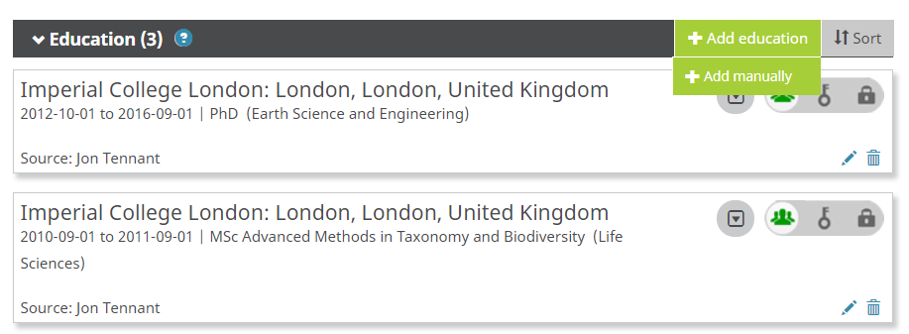
Populating your ORCID profile
OK, so now you have your ORCID profile, it's time to add some content to it!
There are several key areas here:
Education
Employment
Funding
Works
e.g., papers, posters
Peer reviews
@OpenScienceMOOC
www.opensciencemooc.eu

Slide 9
Populating your ORCID profile
The great advantage that ORCID has here is that this information can be ported into other systems, so stops you having to enter the same data over and over again across different platforms.
Here, you can also enter information such as your country of residence, keywords, your website, emails, and other IDs that you might have. It's a good idea here to enter a nice, simple, but comprehensive and professional biography.
For now , there are three ways to help add scholarly works to your ORCID record.
Direct import from other systems;
Import/export via BibTeX; and
Manual addition.
@OpenScienceMOOC
www.opensciencemooc.eu

Slide 10
Direct import of published works
Click the Search and link option.
Define the work type and geographical area. Each time you select one of these, it w ill change the organization options available for you.
Each time you click one of the options, it will take you to the 'oauth' authorization page. Here, make sure only to authorize sources that you trust (which is basically all options) to help keep your data safe.
After authorizing, you w ill be taken to the relevant search page for whichever organization you chose (e.g., CrossRef), automatically populated with a search result for your name.
Now you can simple select which works you want to be added to your own personal profile.
Repeat as needed for each organization until you are happy.
@OpenScienceMOOC
www.opensciencemooc.eu

Slide 11


Slide 12
Create your own Impact Story
ImpactStory is a non-profit dedicated to making scholarly research more open, accessible, and reusable. It helps to provide a fun and lightweight profile that integrates social media mentions, badges, and more with your ORCID record.
Head on over the ImpactStory website. Here, you can join for free using Twitter. If you don't have a Twitter account yet, no worries.
https://profiles.impactstory.org/
After logging in with Twitter, you can link it directly and authorise ImpactStory to use your ORCID profile that you just created in the settings. That's pretty much it!
In the future, you can make sure your profile is up to date in the ImpactStory settings by syncing data from ORCID. It does this automatically, but you can manually update it too, for example whenever you publish a new paper.
@OpenScienceMOOC
www.opensciencemooc.eu

Slide 13
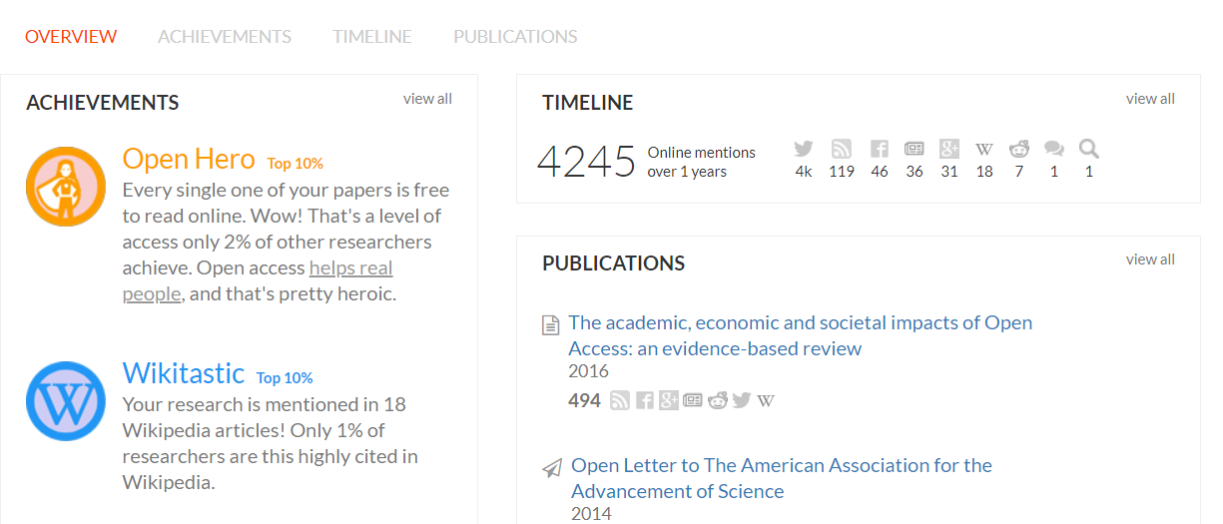
@OpenScienceMOOC
www.opensciencemooc.eu

Slide 14
Understanding your own ImpactStory profile
Overview - The main page that summarises the over three sections.
Achievements - Your badges! These document your success story, including great things like how many of your papers are Open Access, how many are included in Wikipedia, the geographic reach of your work, and, err, whether or not your work has been tweeted by someone named Richard.
Proceed with caution..
Timeline - Regular updates on how and who has been sharing your work across a variety of social platforms, including Twitter, Facebook, Google Plus, blogs, and Wikipedia.
Publications - Based on your publication list from ORCID, with details on all the social media shares for each item.
@OpenScienceMOOC
www.opensciencemooc.eu

Slide 15


Slide 16
Build your peer reviewer profile with Publons
Publons is a platform for researchers to track, verify, and show case their reviewing and editorial contributions for academic journals.
https://publons.com/
It also has the Publons Academy, designed to help with training early-career researchers with peer review.
In 2017, Publons was acquired by Clarivate Analytics, the company which includes products such as Web of Science (and the impact factor), EndNote, and ScholarOne.
At this stage, some of you might not wish to have a profile with this company for various reasons.
@OpenScienceMOOC
www.opensciencemooc.eu

Slide 17
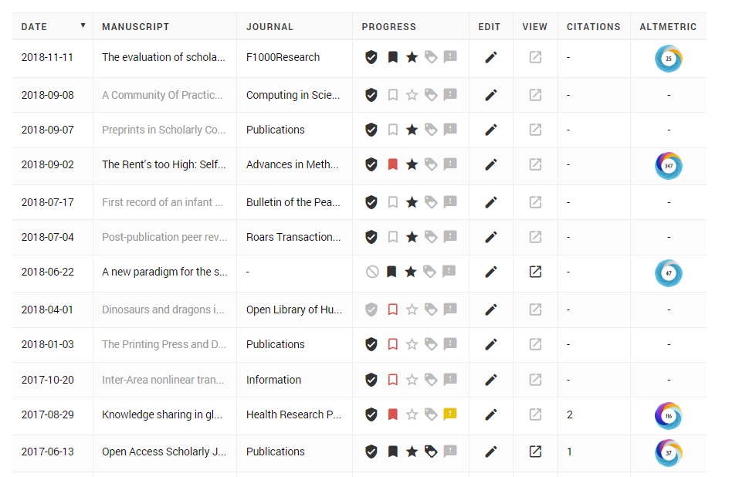
Import your publication record from ORCID
To do this step, simply click 'Publication records' on the left hand side, and then 'Import from ORCID' to populate your publication profile.
Displays citations, Altmetric score, and review status alongside all articles.
@OpenScienceMOOC
www.opensciencemooc.eu

Slide 18


Slide 19
Opening up your research with the Open Science Framework
Head to the Open Science Framework homepage, and click 'Sign up’.
https://osf.io/
Again, you should have a chance here to sign in or sign up using your ORCID profile, or through an institutional profile.
Once logged in, you w ill be taken to your dashboard, which contains a rolling list of the various projects integrated with your OSF profile.
Of course, if you have only just set up your account this will be blank for now.
@OpenScienceMOOC
www.opensciencemooc.eu

Slide 20
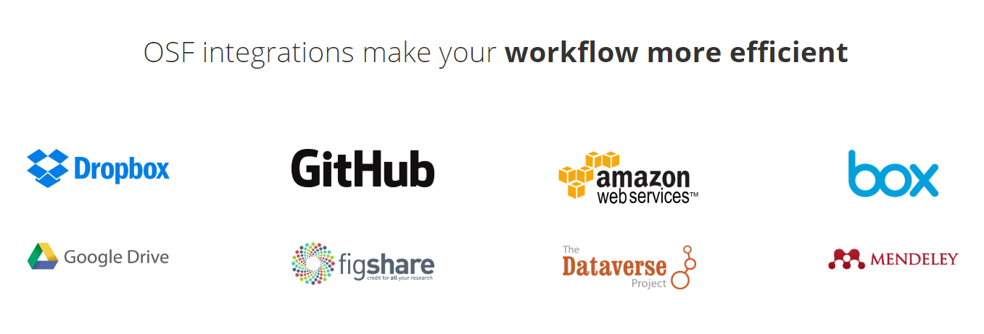
@OpenScienceMOOC
www.opensciencemooc.eu

Slide 21
OSF features
OSF Registries - Which includes more than 270,000 registrations, which you can learn more about here.
OSF Meetings - A place where conference organisers can arrange a free poster and presentation sharing service for their events.
OSF Institutions - Basically the OSF, but operating at the institutional level to increase transparency, collaboration, and visibility of research.
OSF Preprints - A searchable database of more than 2 million preprints, across more than 20 OSF-branded and community-governed platforms.
@OpenScienceMOOC
www.opensciencemooc.eu

Slide 22

@OpenScienceMOOC
www.opensciencemooc.eu

Slide 23
Checklist for this workshop
So hopefully now you have the basics elements of your personalised, online researcher profile completed. This provides a great way to show case your work, increase and track your research impact, and receive appropriate credit for all of this.
Just to make sure, now you should have:
A personal ORCID profile, with any publications associated with this.
An ImpactStory profile to help track and show case the social attention that your research gets.
An Open Science Framework profile, to begin openly collaborating and managing your research.
And optionally, a Publons profile, to track your peer review record.
@OpenScienceMOOC
www.opensciencemooc.eu

Slide 24
Next steps?
From here on, much of this will be automatically populated as your work progresses.
But some advice is to check your ImpactStory regularly, to see who is sharing your work and in what context, and to make sure that as much of your research is openly available (e.g., code, articles, data) via the Open Science Framework as possible.
Finally, if you created a Publons profile, make sure to update this as you review new articles in the future to keep track of this important work.
How you develop your own digital research profile in the future will be down to each individual, but hopefully this is enough for now to give you a good boost!
@OpenScienceMOOC
www.opensciencemooc.eu

Slide 25
Thanks! How to stay in touch:
Join our open Slack channel: https://osmooc.herokuapp.com/
Join our open GitHub team: https://open-science-mooc-invite.herokuapp.com/
Follow us on Twitter: @OpenScienceMOOC
Email: info@opensciencemooc.eu
Join our mailing list: https://opensciencemooc.eu/contact/
Join us on Facebook: https://www.facebook.com/OpenScienceMOOC

